Slide 1
BYPASS &
COMPRESSION RATIO
Limiting Factors and Design Tradeoffs
Engineer Name | Advanced Concept Development | Date

Slide 2
Bypass Ratio
FAN AND CORE SIZING, PROPULSIVE EFFICIENCY

Slide 3
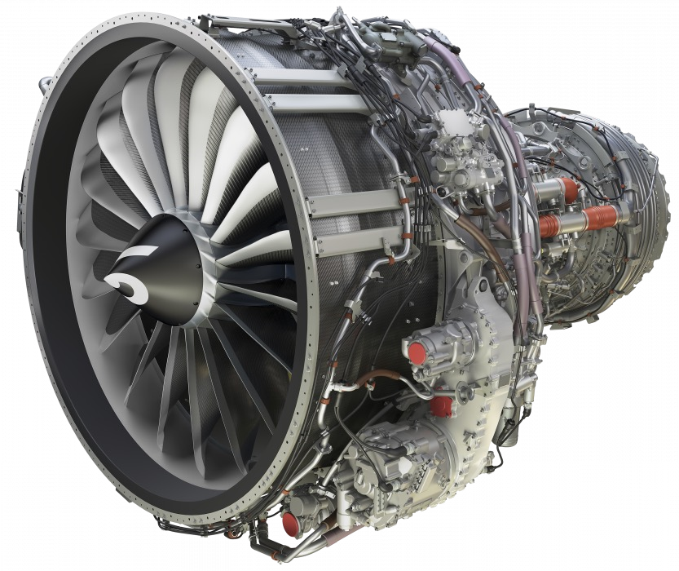
Increasing Bypass Ratio
Higher bypass ratio improves propulsive efficiency Bypass ratio can be increased by:
Increasing fan size (in relation to engine core)
Decreasing core size (in relation to fan)
Leap-1B. (n.d.). Retrieved January 3, 2023, from https://www.safran-group.com/products-services/leap-1b-new-generation-engine-single-aisle-commercial-jets.

Slide 4

Bypass Ratio Limitations
Tip Speed
Increased fan diameter = lower allowable rotational velocity
Engine core optimal rotational velocity likely higher than fan rotational velocity optimum or limit
Material Strength
Increased blade diameter = increased bending moments and stresses on blades
Installation Considerations
Must fit under wing of narrow-body aircraft without ground strike, or on rear of fuselage, etc.
Cfm Leap on 737-Max. (n.d.). Flight Global. Retrieved January 3, 2023, from https://www.flightglobal.com/engines/cfm-to-build-10-737-max-engines-weekly-for- 2020/136959.article.

Slide 5
Increased Bypass Ratio
PROS
Improved propulsive efficiency (higher mass- flow, reduced fuel burn)
Improved static thrust (takeoff, climb performance)
CONS
Installation difficulties
Difficult to balance core rotational velocity requirements with fan rotational velocity limitations

Slide 6
Compression Ratio
COMPRESSOR AND COMBUSTOR, THERMAL EFFICIENCY

Slide 7
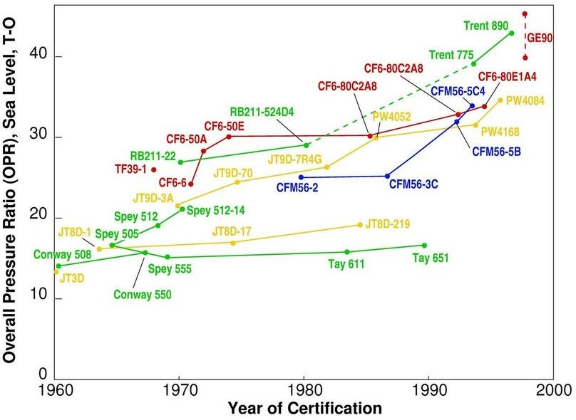
Increasing Compression Ratio
Higher compression ratio improves thermal and combustive efficiency
Compression ratio can be increased by:
Increasing core rotational velocity (if core diameter is kept the same)
Increasing core diameter (larger compressor blades, more energy put into air compression)
Increasing number of stages in compressor
Adding supplementary fan stages that ‘pre- compress’ air
Epstein. (n.d.). Figure 11.9: Pressure ratio trends for commercial transport engines (Epstein, 1998). 11.5 trends in thermal and propulsive efficiency. Retrieved January 3, 2023, from http://web.mit.edu/16.unified/www/FALL/thermodynamics/notes/node84.html

Slide 8
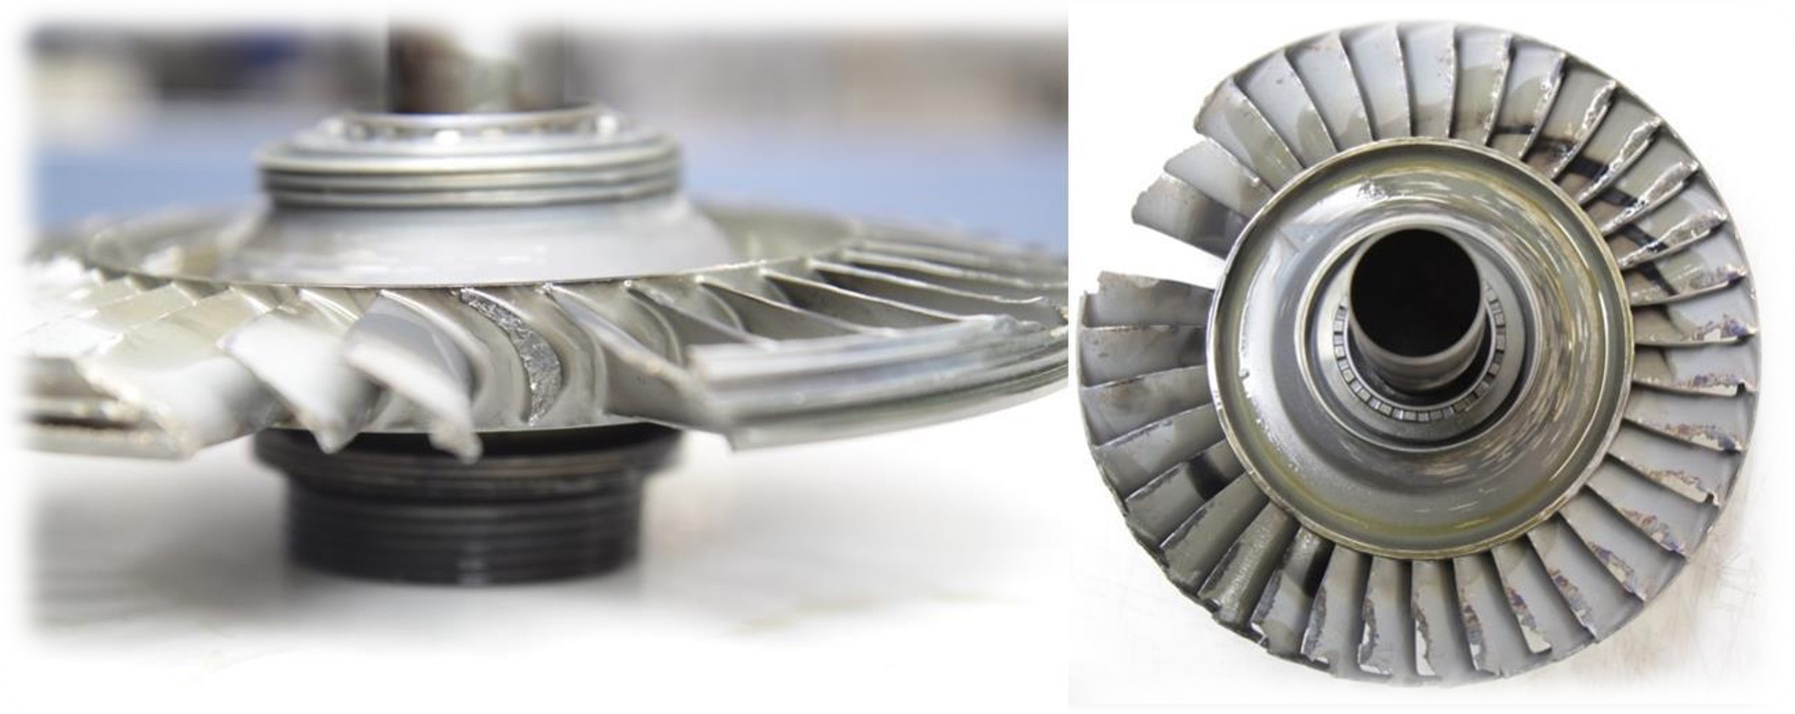
Compression Ratio Limitations
Material Strength
Increased compression = increased forces on compressor blades
Thermal Limits
Increased compression = higher air temperatures at compressor and in combustor
Material strength changes with temperature changes
Limitations on compressor blade strength
Limitations on combustor liner thermal resistance
Limitations on turbine blade strength
NOx generation at elevated combustion temperatures
Rotational Velocity Balance
Core typically wants to operate at higher rotational velocity (increased compression) while fan generally requires lower velocity
Chua, A. (2020, March 12). Fatigue cracking in turbine blade led to AS355 F1 engine failure. Flight Global. Retrieved January 3, 2023, from https://www.flightglobal.com/aerospace/fatigue-cracking-in-turbine-blade-led-to-as355-f1-engine-failure/137211.article

Slide 9
Increased Compression Ratio
PROS
Improved combustive efficiency (more energy extraction for same fuel use)
Increased power for given core size
CONS
NOx generation, emissions concerns
Material thermal capabilities limiting

Slide 10
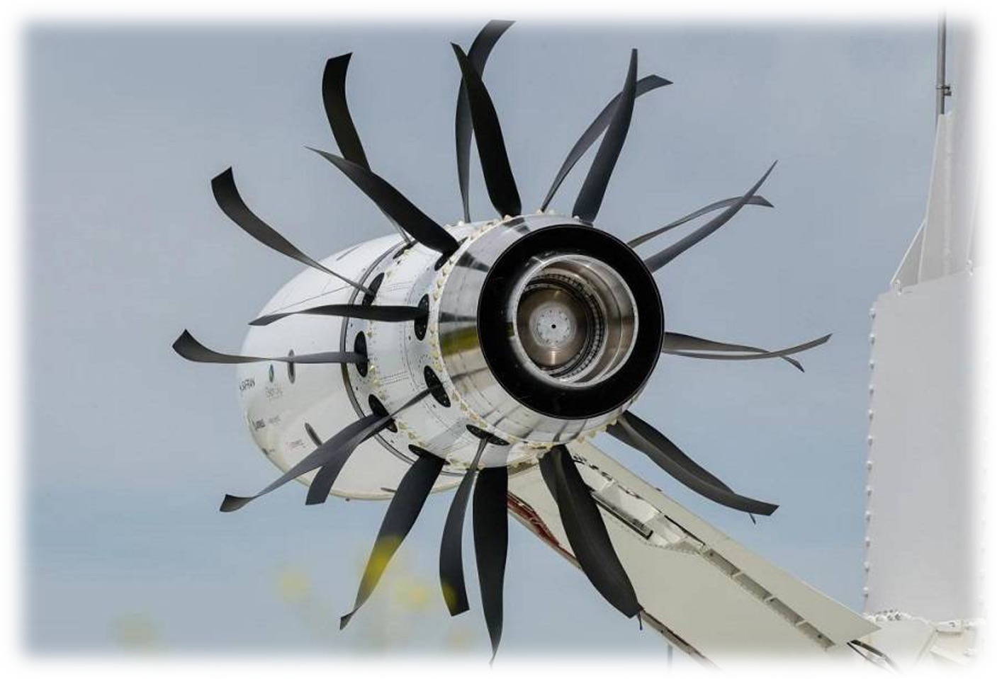
General Tradeoffs in Engine Sizing
Increased Bypass Ratio
Improved propulsive efficiency
Increased difficulty in installation and material strength
Possible increased noise
Difficulty balancing rotational velocity for fan and core optimum conditions
Increased Compression Ratio
Improved thermal efficiency
Increased thermal demand on combustor and turbine materials
Increased load on compressor blades, material limitations
Possible NOx generation and emissions concerns
Spyros Georgilidakis (2021, June 14). CFM RISE: GE & Safran to develop Open Rotor Engine! Mentour Pilot. Retrieved January 3, 2023, from https://mentourpilot.com/cfm-rise-ge-safran-to-develop-open-rotor-engine/

